Slide 1

TRAFFIC MANAGEMENT
ENHANCING MOBILITY AND SAFETY
submitted by:
1. Naveenraj.E
2.Manimaaran.M
3.Sachin.M
4.Sanmugam.P
5.Sakthivel.S

Slide 2
Introduction
Introduction to the topic
Importance of effective traffic management
Purpose of the presentation
Key challenges
Congestion
Road maintenance
Urbanization
Sustainability
Tech

Slide 3
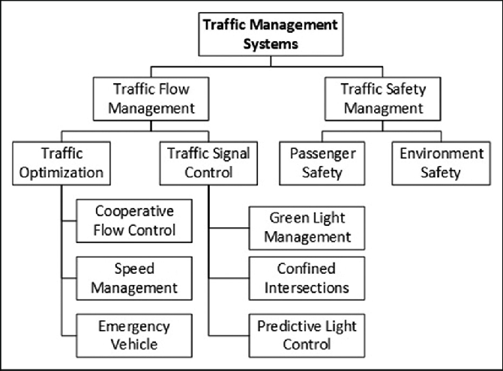
Overview of traffic management
Brief overview of traffic management system
Key challenges in urban traffic management
Smart traffic signals
Traffic management apps
Electric and autonomus
vehicles

Slide 4
Traffic flow and congestion
Explain the concept of traffic flow and congestion
Illustrate the impact of congestion on cities
This measures how closely vehicles are spaced on a road
Low density traffic has more space between vehicles, while high-density traffic is more tightly packed

Slide 5
Role of traffic management
Discuss the role of traffic management in reducing congestion
Ensuring safety and efficient movement
It helps reduce the risk of accidents and ensures that traffic moves in an organized and predictable manner

Slide 6
Traffic management components
Detail the key components of traffic management system
Traffic signals,signage,road design,and technology
Traffic laws establish rules and regulations that govern drive behaviour on the road

Slide 7
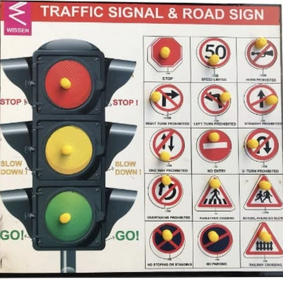
traffic signals
Explain the function of traffic signals
Types of traffic signals and their significance
1. Red Traffic Signlas
2. Green Traffic Signals
3. Yellow Traffic Signals

Slide 8
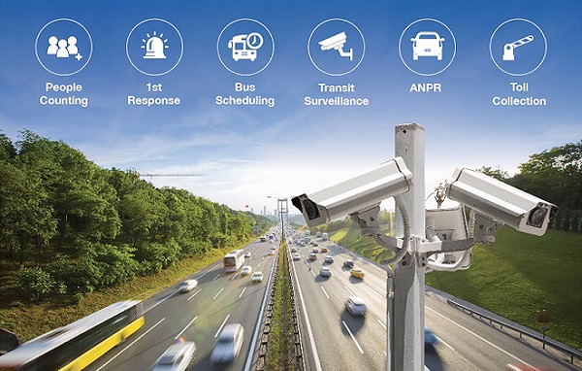
Intelligent transportation systems(ITS)
Discuss the role of ITS in traffic management
Examples:traffic cameras,sensors,and data analytics
ITS includes the use of advanced traffic conditions, control traffic signals, and optimize traffic flow

Slide 9
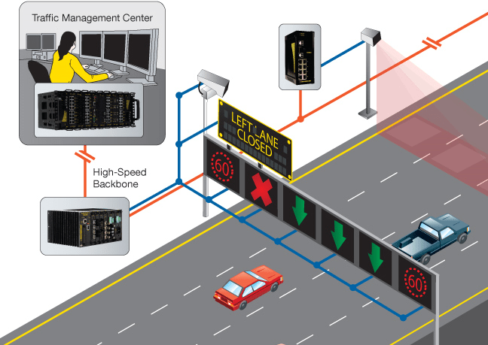
Traffic management tecnologies
Highlight various technologies used in traffic management
Real-time traffic data
Adaptive traffic signal system
Intelligent transportation system
Dynamic message signs
Traffic cameras

Slide 10
Traffic congestion solutions
Present strategies for alleviating traffic congestion
Public transportation, carpooling, and congestion pricing

Slide 11
Smart cities and traffic management
Explain how smart city initiatives integrate traffic management
Data-driven decision-making and sustainability

Slide 12
Case studies
Provide real –world examples of successful traffic management impementations
Highlight outcomes and improvements

Slide 13
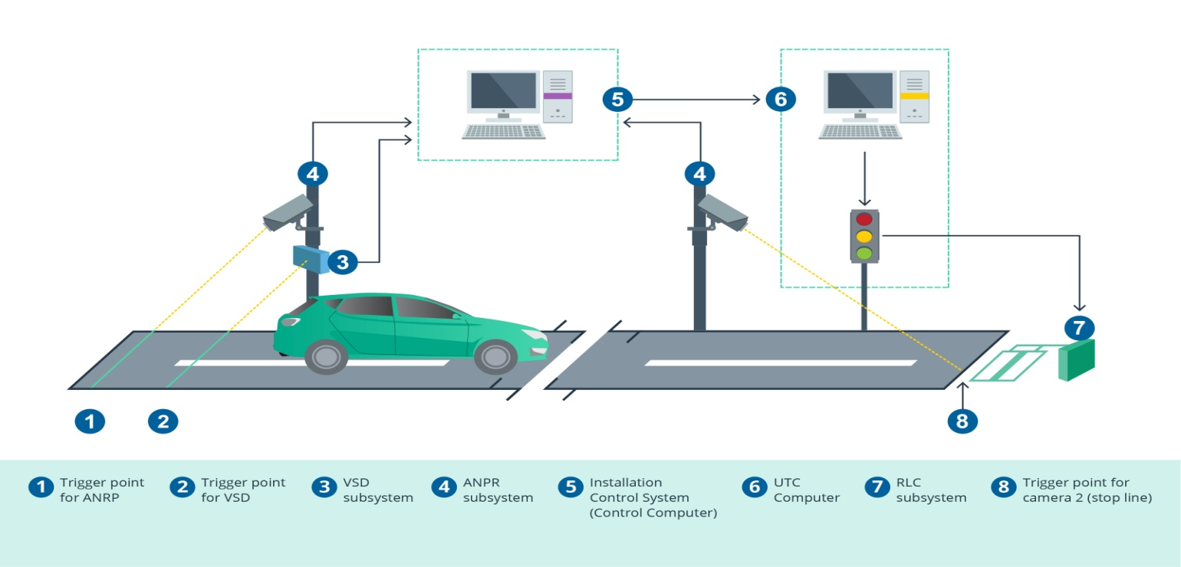
Challenges and solutions
Discuss the challenges faced in traffic management
Propose solutions and best practices

Slide 14
Future trends
Explore upcoming trends in traffic management
Autonomous vehicles and connected infrastructure

Slide 15
Safety and environmental impact
Address how effective traffic management contributes to safety
Reducing acciedents and environmental impact

Slide 16
Conclusion
Summarize key points
Emphasize the importance of traffic management of cities

Slide 17
THANK
YOU

